Slide 1
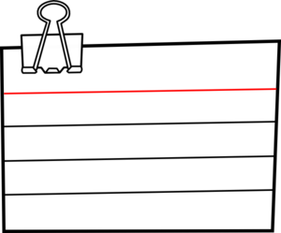
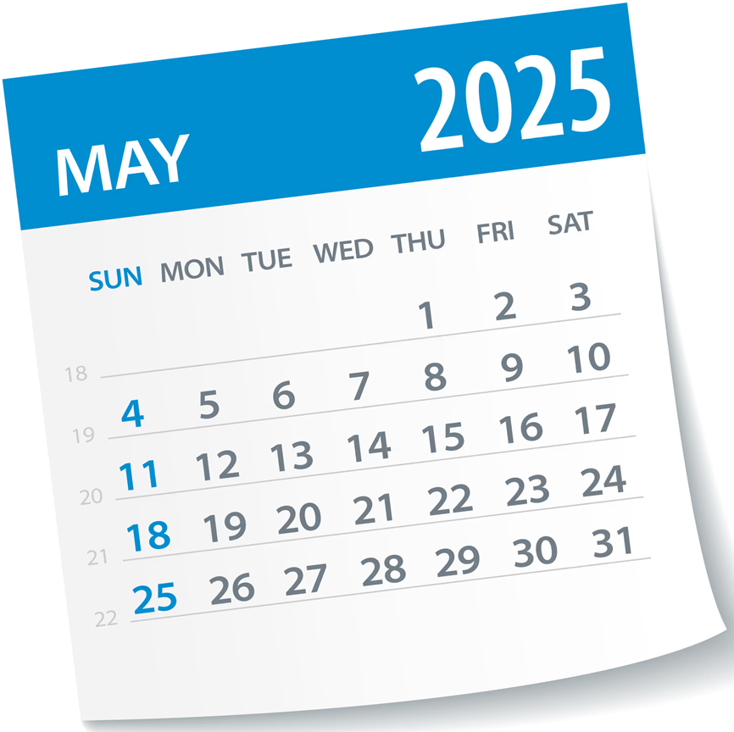
Tues 6th May
Tues 13th May
2
1
Number and
Measure L2
Biology
Paper 1
Morning: 9am
Afternoon: 1pm
1hr 30m
1h 45m
Mon 19th May
3
4
Thurs 15th May
FS Maths L1/2
Maths (Non-Cal)
Paper 1 & 2
Paper 1
Morning: 9am
Morning: 9am
1hr 55m
1h 30m
Fri 23rd May
6
Thurs 22nd May
English Language
5
Paper 1
Sport
Science
Morning: 9am
Afternoon: 1pm
1h 45m
1h 15m
Exams Summer 2025
7
Wed 4th June
8
Maths (Cal)
Fri 6th June
Paper 2
English Language
Morning: 9am
Paper 2
1h 30m
Morning: 9am
1h 45m
Mon 9th June
9
Biology
Paper 2
Morning: 9am
1h 45m
* Contingency Days
10
Thurs 12th June
Students will need to remain available to take exams until
25th June
Wed 11th June
11
11th & 25th June
Maths (Cal)
FS English
Paper 3
Reading/Writing L1/2
Morning: 9am
Morning: 9am
English Literature - Monday 12th May 2025 – 9am – 1hr 45mins
Tuesday 20th May 2025 – 9am – 2hrs 15mins
1h 30m
1h Reading / 1hr Writing

